Slide 1

The Impact of Color, Emotion, and Simplicity in Advertisements on Consumer Behavior
A Research Study Among Students of Rajshahi University
PRESENTED BY: MD. NAIM MOLLA | ID: 2110924125 | SESSION: 2020-21
Department of Statistics, University of Rajshahi, Bangladesh

Slide 2
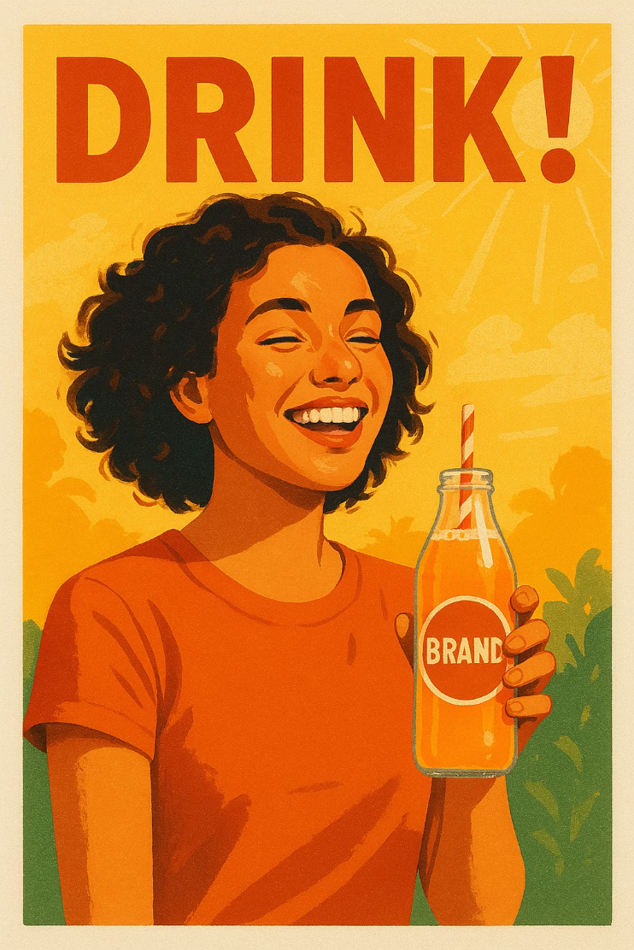

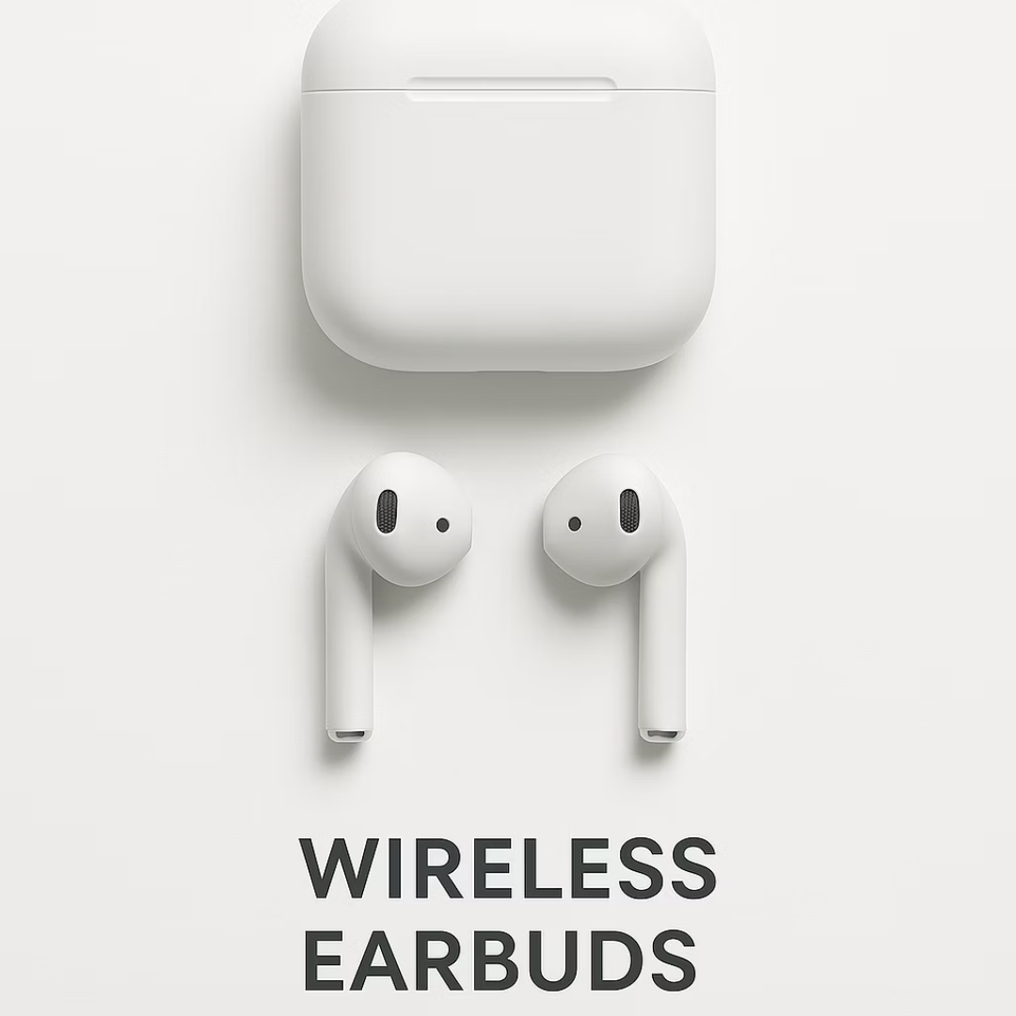
Visual Measurement Methods
🎨 Color Testing
😊 Emotion Testing
✨ Simplicity Testing
We test warm and saturated colors to see how they affect people's feelings and attention.
We measure how emotional faces in ads change what people think about products.
We test how clean, simple designs affect people's attention and overall appeal.
1

Slide 3







Presentation Outline
Unveiling the psychological drivers of effective advertising through a comprehensive research study.
This presentation takes you through our robust methodology and compelling findings on how color, emotion, and simplicity profoundly influence consumer decisions, offering actionable insights for impactful campaigns.
Introduction & Background
Aim and Objectives
Literature Review & Research Gap
Materials and Methods
Key Findings & Discussion
Conclusion & Recommendations
2

Slide 4

The Power of Visuals in Advertising
In today's busy market, great ads are crucial for grabbing attention and helping people choose what to buy. What an ad looks like — its visuals — is super important for how people see a brand.
Color Power
Colors make you feel things and change how you see a brand. Think blue for trust, red for excitement!
Emotional Appeal
Ads that make you feel something are remembered better and
make you want to act.
Simplicity is Key
Easy-to-understand ads are clearer, less confusing, and get the
message across faster.
3
We studied university students because they are young, use a lot of digital media, and quickly notice new trends. Their opinions on ads are very helpful for marketers.

Slide 5




Aim and Objectives
The primary aim is to examine the impact of color, emotion, and simplicity in advertisements on consumer behavior among students of Rajshahi University.
Color Influence
Emotional Effect
Assess how color influences consumer perception and purchase intention.
Evaluate the effect of emotional appeal on consumer engagement and decision-making.
Simplicity's Role
Combined Influence
Analyze how design simplicity affects consumer understanding and preference.
Investigate the joint influence of all three factors on student consumer behavior.
4

Slide 6


Review of Literature
Impact of Color
Emotional Appeal
Simplicity in Design
Colors attract attention, influence emotional responses, and affect brand recognition and purchase intention (Elliot & Maier, 2014; Labrecque & Milne, 2013).
Emotional content creates memorable experiences, fosters brand loyalty, and enhances purchase intention, especially positive emotions (Bagozzi et al., 1999).
Simple, uncluttered designs reduce cognitive overload, ensuring the message is clear, comprehensible, and memorable (Huang & Chen, 2006).
Advertisements are no longer merely informational; they are designed to create emotional connections, capture attention, and persuade consumers toward specific actions.
5

Slide 7
The Research Gap
Few Local Studies
While there's a lot of global research, not many studies look at the combined power of color, emotions, and simple design here in Bangladesh.
Most local research looks at these things one by one. They don't often explore how they all
work together to shape what people buy.
Focus on Young People
There's also limited research on how young adults (like college students) react to ads. This group is a huge part of today's online shoppers.
This study aims to fill these gaps! We'll explore how color, emotion, and simplicity together affect the buying interest of students at Rajshahi University, giving us local insights.
6

Slide 8







Materials and Methods
Type of Study
Study Population
Data Collection Method
A quantitative cross-sectional survey design was utilized, capturing a snapshot of perceptions regarding color, emotional appeal, and simplicity at a single point in time.
The target population comprised undergraduate and postgraduate students at Rajshahi University, Bangladesh, representing a significant portion of the digital consumer market.
Data were collected through a structured questionnaire administered electronically, designed to assess student perceptions and purchase intentions related to the studied variables.
Sampling Procedure
Sample Size
Data Management
Non-probability convenience sampling was employed due to accessibility and time constraints, selecting participants readily available and willing to participate from the university student body.
A total of 253 students participated in the study. The minimum required sample size was determined to be 246 using Cochran's formula, ensuring statistical validity.
Collected data were securely stored and meticulously checked for completeness and consistency. Confidentiality and anonymity of participants were strictly maintained throughout the process.
Data Analysis Technique
Descriptive statistics, Chi-square (χ²) tests for association, Correlation analysis (Spearman's rho and Pearson) were employed to analyze the collected data and test the research hypotheses.
7

Slide 9


Demographic Profile of Participants
Gender Breakdown
Academic Level
Female
Male
Undergraduate
Postgraduate
Age Distribution
18-20 years: 40%
Fields of Study
21-23 years: 35%
Business & Social Sciences: 40%
24-26 years: 15%
Science & Engineering: 35%
27+ years: 10%
Arts & Humanities: 20%
Other Disciplines: 5%
8

Slide 10




Visual Elements and Brand Loyalty
This section looks at the connection between pictures and designs in ads and how university students become loyal to brands, showing what makes them choose certain brands.
Brand Recognition
Repeat Buys
Unique logos and consistent ad pictures really help students remember brands. **75%** of them recognize brands just by looking at their visuals, even without words.
Students who see good-looking and steady visual branding are **40% more likely** to buy from that brand again. Pictures that create good feelings work especially well.
Brand Trust Factors
Visual Appeal & Lasting Preference
Professional and high-quality visual ads make brands seem more trustworthy. **60% of students** said that good-looking visuals make a brand seem more reliable and honest.
When ads tell a good story with strong visuals, it creates an emotional link that leads to students preferring the brand for longer. Brands using engaging visuals get **25% higher loyalty rates** among university students.
9

Slide 11

Key Finding: Color Scheme Impact
Correlation: ρ = 0.162, p = 0.010
Pleasant color schemes are significantly associated with higher ad liking. Students who perceived colors favorably also reported greater advertisement appeal and positive purchase intentions.
Positive Correlation
Weak Effect Size
Practical Implication
Favorable color perception linked to increased ad liking.
Color influences initial reactions but other factors play larger roles.
Use color as a supporting element complementing other design features.
10

Slide 12

Emotional Intensity & Trust
Correlation: r = 0.167, p = 0.008
Stronger emotional responses in advertisements are associated with greater perceived product trustworthiness. Emotional engagement contributes to building consumer confidence in products.
Emotional Connection
Trust Building
Ads evoking stronger emotions increase perceived product reliability.
Emotional storytelling enhances consumer confidence when combined with clarity and credibility.
Strategic Use
Integrate emotional content but don't rely solely on emotional cues for persuasion.
11

Slide 13
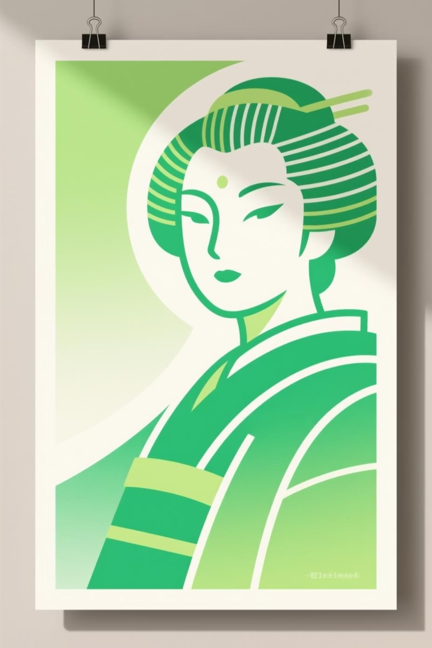
Simplicity & Purchase Intention
Correlation: r = 0.134, p = 0.033
Simple, clear ad designs positively influence purchase intention. Students perceiving ads as straightforward were more likely to consider buying products. Simplicity reduces cognitive load and improves message focus.
1
Clarity Advantage
Simple designs help consumers focus on key product messages.
2
Modest Effect
While significant, simplicity accounts for only a small portion of purchase decision variance.
3
Balance Required
Combine simplicity with visual appeal and emotional engagement for maximum effectiveness.
12

Slide 14

Student Preferences: What Works Best
45.1%
34.4%
20.6%
73.1%
Color-Based Ads
Simplicity-Based Ads
Emotion-Based Ads
Prefer Simple Designs
Most effective for driving purchase consideration.
Second most influential design approach.
Least decisive for initial purchase consideration.
Overwhelming majority favor uncomplicated aesthetics.
13

Slide 15






Study Limitations
Understanding the constraints of our research is crucial for interpreting the findings accurately. This study presents several
key limitations
Sample & Sampling
Geographic Scope
The study's findings are limited by its sample size and specific sampling methodology, which may affect its representativeness.
Research was confined to Rajshahi University, restricting broader applicability to other educational institutions or regions.
Time Constraints
Self-Reported Data
Utilizing a cross-sectional design means data was collected at a single point, limiting insights into long-term trends or causal relationships.
Reliance on self-reported information introduces potential biases such as social desirability or recall inaccuracies.
Generalizability
Methodological Factors
Given the specific context and participant pool, the results may have limited generalizability to diverse populations.
Other inherent methodological limitations may exist, influencing the study's scope and
14

Slide 16






Conclusion and Recommendation
Our study really helped us see how much pictures and designs in ads affect college students, and how well ads work for them.
Conclusion
Our Main Discoveries
How It Changes Students
Proof We Can Trust
We found clear connections between using colors, feelings, and simple ads and how well those ads grab people's attention and get them interested.
This study showed that these visuals and feelings really change what students think and if they want to buy something.
All the connections we found were very strong and statistically proven. This means our ideas are solid and you can trust our conclusions.
Recommendation
For People Making Ads
For Future Studies
How to Use This Now
Use bright, emotional colors and make your ads clear and to the point. This works best for younger people like students!
Next time, let's look at these ideas in different countries and with different age groups. We should also follow people over a longer time to see how things change.
Try testing different color choices and emotional messages in your online ads. This will help you find what works best to get people interested and buying your product.
15

Slide 17
References
Aaker, D. A. (1991). Managing brand equity: Capitalizing on the value of a brand name. Free Press.
Gorn, G. J., Chattopadhyay, A., Yi, T., & Dahl, D. W. (2008). Effects of product color on consumer behavior: A critical review. Journal of Consumer Psychology, 18(2), 116–128.
Heath, R., & Nairn, A. (2005). Measuring advertising effectiveness: The case for emotional engagement. International Journal of Advertising, 24(2), 183–197.
Keller, K. L. (2013). Strategic brand management (4th ed.). Pearson Education.
Kotler, P., & Armstrong, G. (2021). Principles of marketing (18th ed.). Pearson.
Luscher, M. (2018). The Luscher color test. Pocket Books.
Petty, R. E., & Cacioppo, J. T. (1986). Communication and persuasion: Central and peripheral routes to attitude change. Springer.
Plassmann, H., Venkatraman, V., Huettel, S., & Wager, T. D. (2015). Bias in the brain: A meta-analysis of neural mechanisms of placebo, expectation, and marketing effects. Journal of Consumer Psychology, 25(2), 173–193.
Singh, S. (2006). Impact of color on marketing. Management Decision, 44(6), 783–789.
Smith, R., & Jones, T. (2021). Chromatic branding: How color influences consumer perception and brand recall. Psychology & Marketing, 38(10), 1735–1750. https://doi.org/10.1002/mar.21528
16

Slide 18
Thank You!
We sincerely appreciate your attention and engagement during our presentation.
Any question ?

